Slide 1






International Women in Engineering Day (INWED 2025)
June 20, 2025, Singapore.
Minimum Depth Quantum Modular Addition through Carry-Save Architecture
Authors
Siyi Wang¹, Eugene Lim¹, Xiufan Li², Jerrie Feng¹, and Anupam Chattopadhyay¹
Affiliations
1 Nanyang Technological University, Singapore.
2 Centre for Quantum Technologies, National University of Singapore, Singapore.
Email
Siyi002@e.ntu.edu.sg

Slide 2

01 Introduction
02 Research Question
03 Contribution
04 Method
05 Results
06 Conclusion
CONTENT

Slide 3


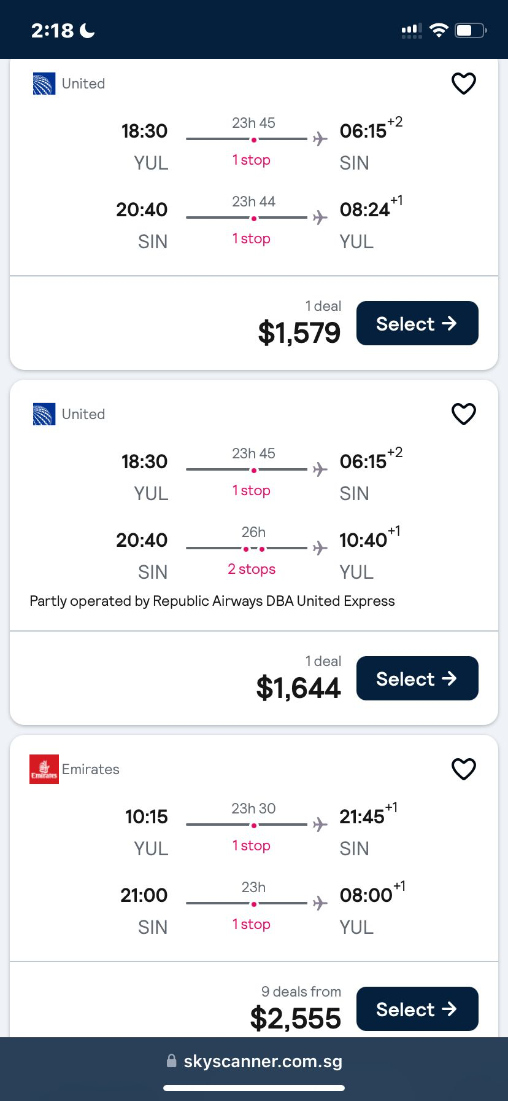
Introduction
Let’s Imagine...
It’s a normal day. Ms. Luisa has just decided to buy a ticket to Singapore, to attend the International Women in Engineering Day this year.
Unfortunately, she is unable to complete the payment because all the money in her account was stolen by a quantum attacker.
Ms. Luisa is shocked. She immediately calls the bank manager...

Slide 4


Introduction
Public Key Encryption (RSA, ECC, ...)
High Security
Classical computers: several billion years to break.
Applications
Banking systems, secure communications......
Quantum Attack
Attack Private-key Encryption
Grover’s Algorithm, Simon’s Algorithm, ......
Attack Public Key Encryption
Shor’s Algorithm^{[1]}, ......
Shor's Algorithm
Attack Public Key Encryption
Can break RSA in 8 hours.
Most Resource-Intensive Component
Modular Exponentiation,
Relies on modular addition.

Slide 5


Research Question
How to improve the efficiency of Quantum Modular Addition?

Slide 6
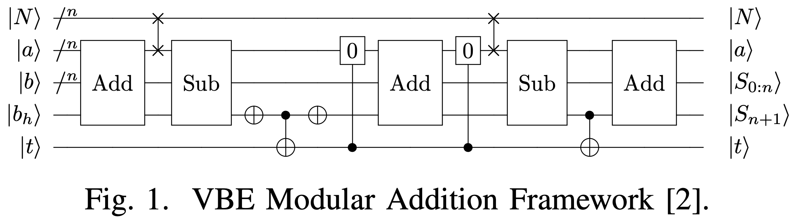
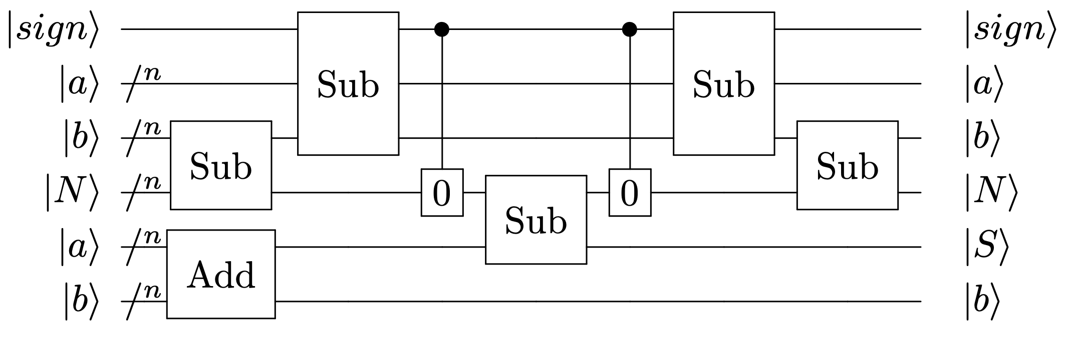
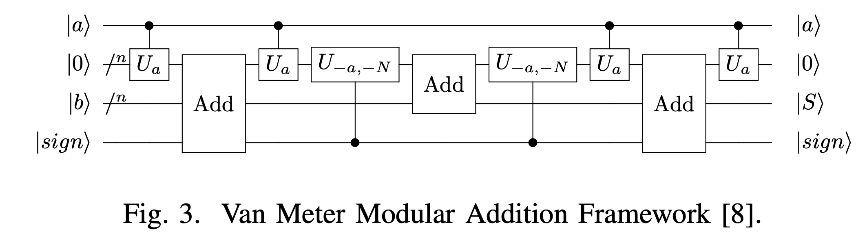
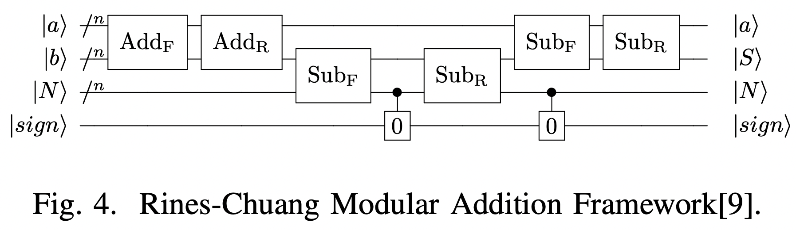
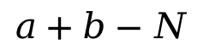
Contribution 1
Highlight the Potential of the Carry-save Architecture
VBE Modular Addition Framework^{[2]}
Beckman Modular Addition Framework^{[3]}
Van Meter Modular Addition Framework^{[4]}
Rines-Chuang Modular Addition Framework^{[5]}
$$a+b−N$$

Slide 7
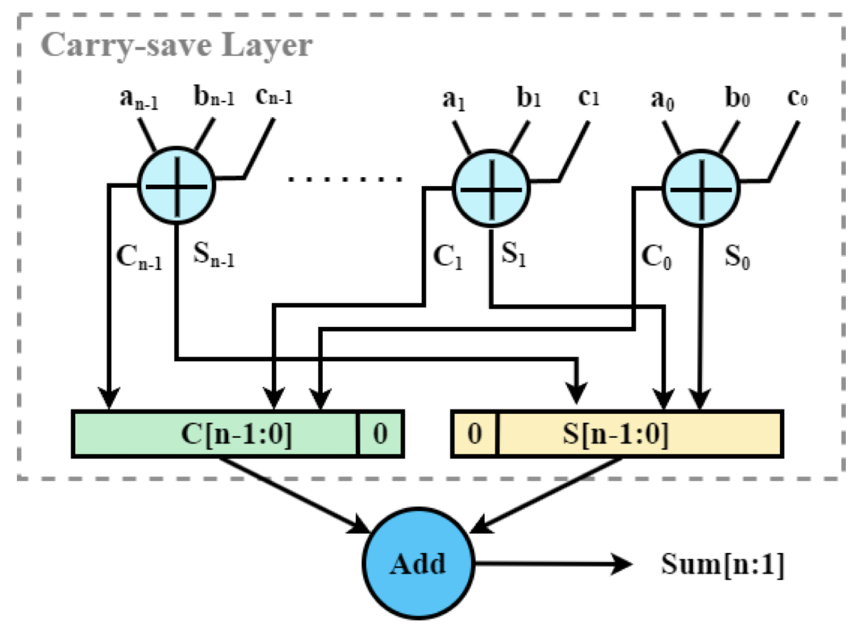
Contribution 2
Propose a Novel Modular Addition Framework based on Carry-save Architecture.
Carry Save Structure
High-Speed, Low-Cost with Low Latency
Minimizes delay by avoiding the need for immediate carry propagation.
Efficient Multi-Operand Addition
Reduces the time required for multi-operand additions.
Contribution 3
Accelerate Shor’s algorithm through improving modular addition efficiency.

Slide 8
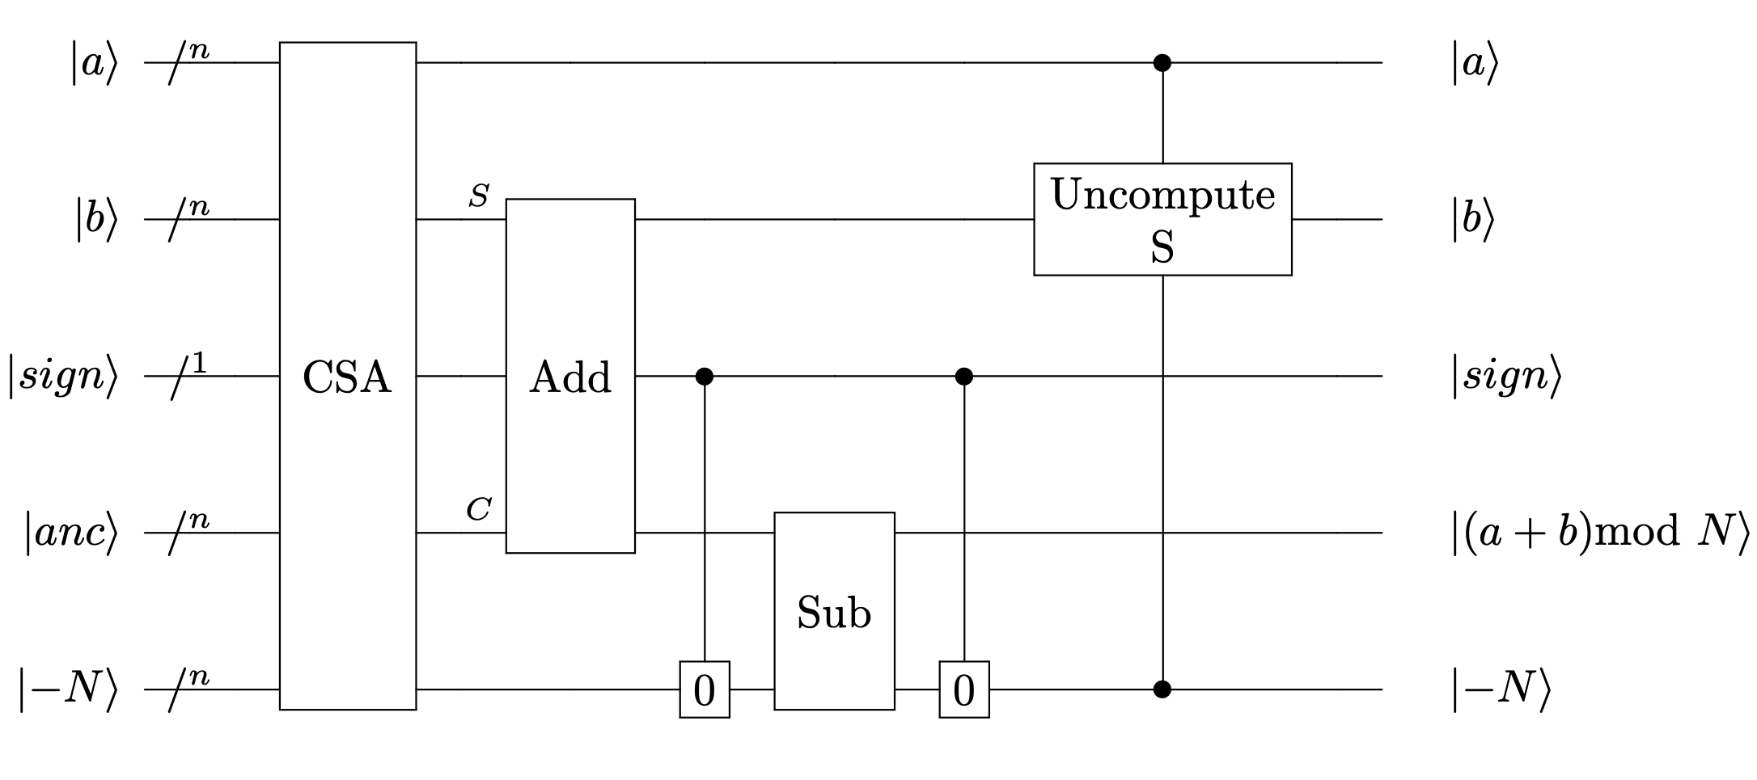
Method
Proposed Modular Addition Framework
CSA Module
Uncompute S Module
Set 0 Module
Add Module
Sub Module

Slide 9
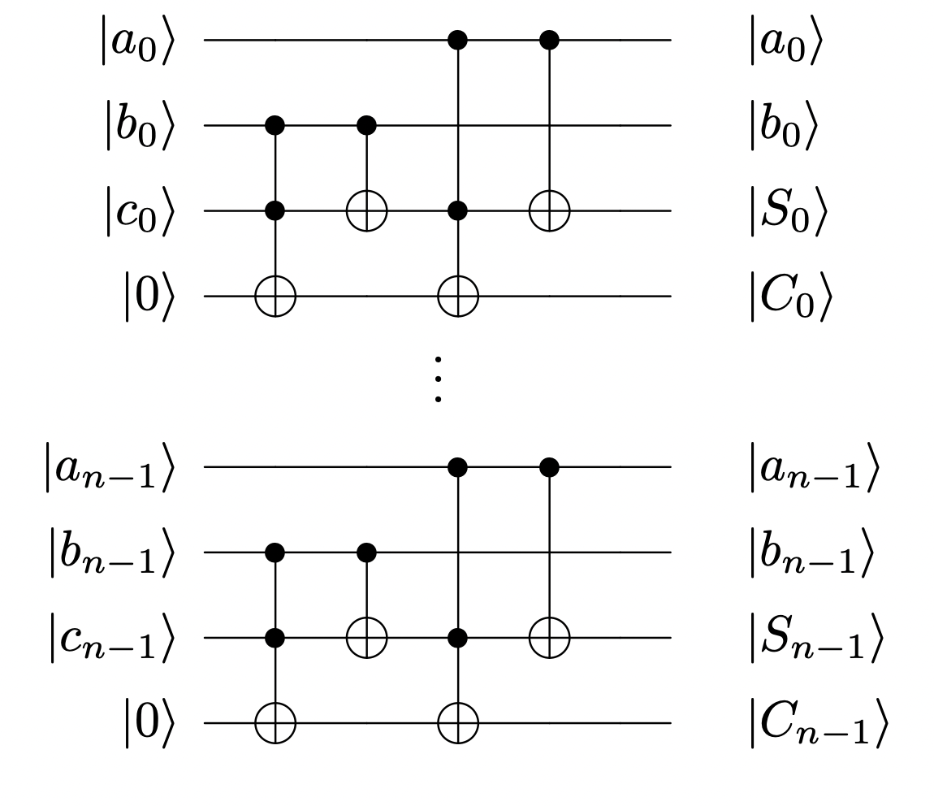
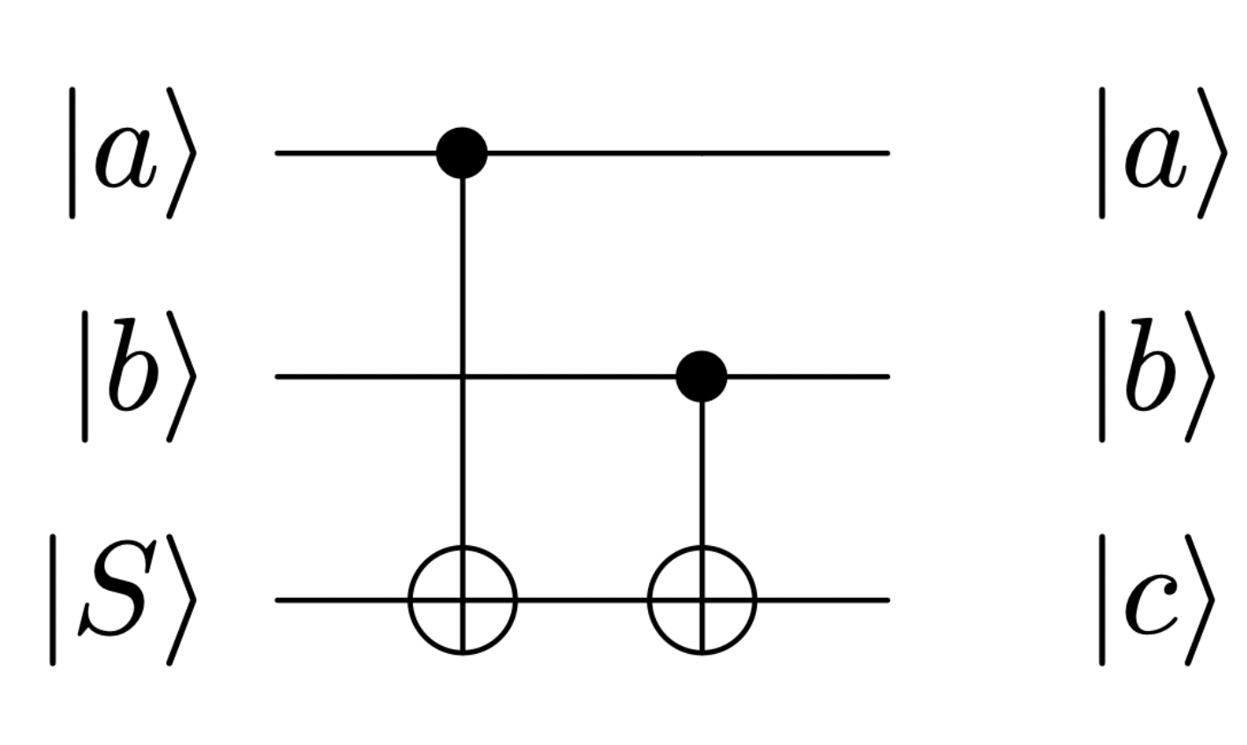
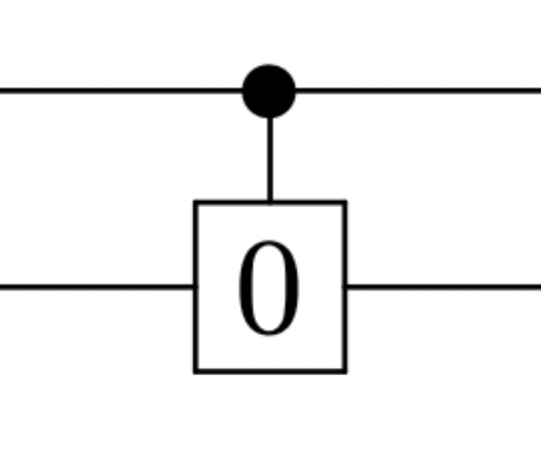
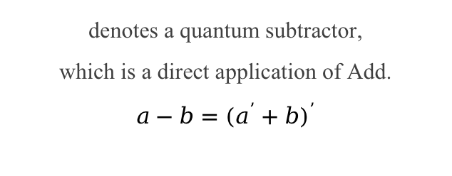
Method
Main Modules
Add Module
Sub Module
represents a quantum adder.
There are various quantum adders.
denotes a quantum subtractor,
which is a direct application of Add.
$$a−b={(a^{’}+b)}^{’}$$
CSA Module
Uncompute S Module
Set 0 Module
represents the carry-save architecture, consisting of a series of full adders operating in parallel.
uncompute the partial sum S,
which can be achieved through CNOTs.
can be implemented using CNOTs.

Slide 10
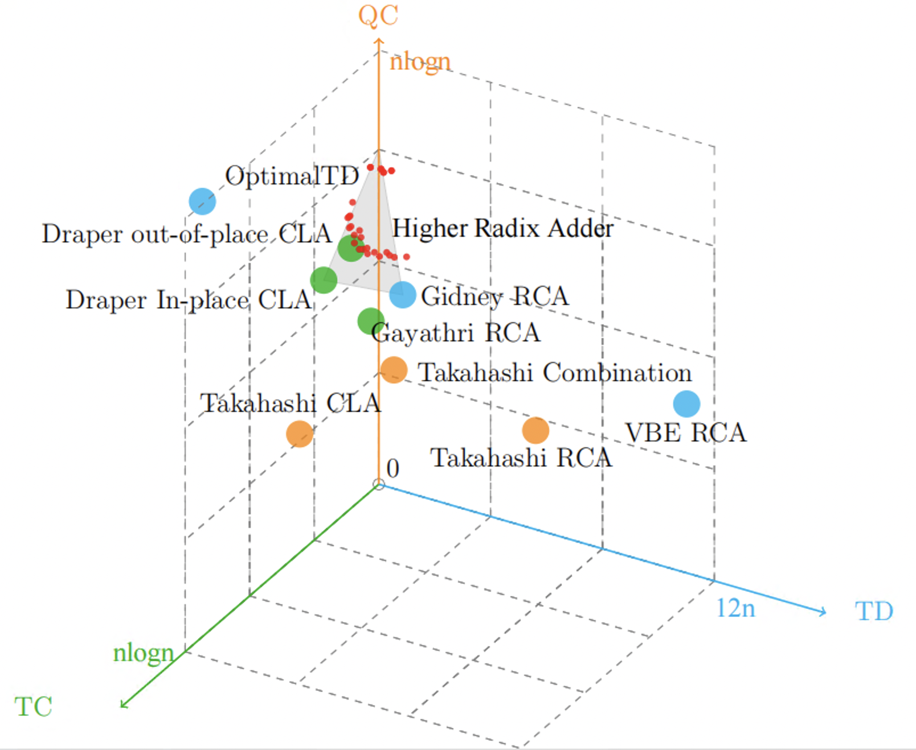
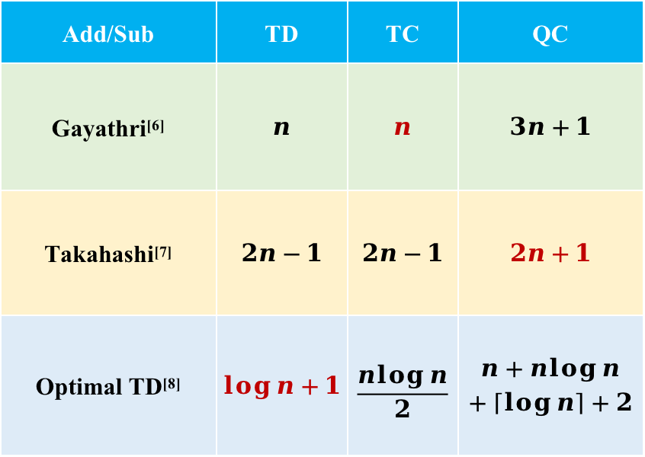
Method
Add/Sub Module
Add/Sub | TD | TC | QC
Gayathri^{[6]} | $$n$$ | $$n$$ | $$3n+1$$
Takahashi^{[7]} | $$2n−1$$ | $$2n−1$$ | $$2n+1$$
Optimal TD^{[8]} | $$\log{n}+1$$ | $$\frac{n\log{n}}{2}$$ | $$n+n\log{n}$$ $$+\left\lceil \log{n}\right\rceil +2$$

Slide 11
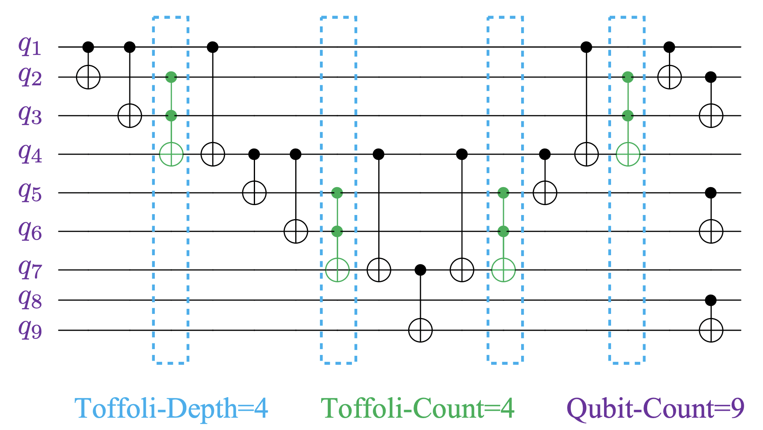
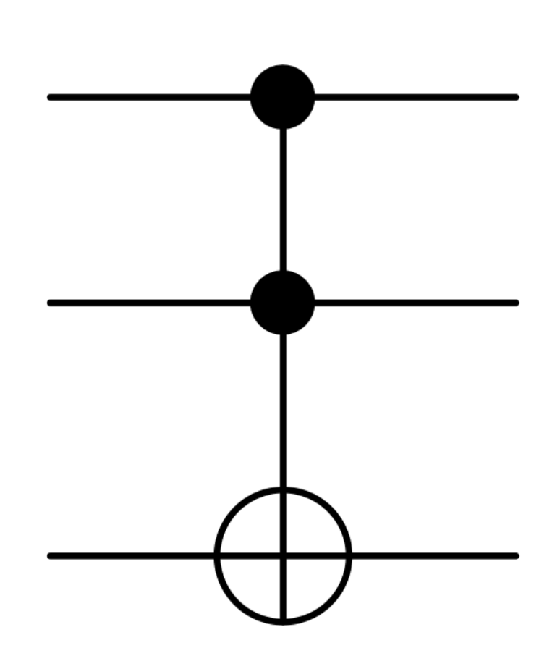
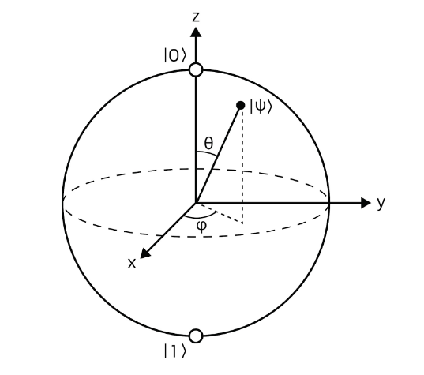
Results
Evaluation Metrics
Most Expensive Quantum Resouces
Toffoli Gate
Qubit
Toffoli-Depth (TD)
Toffoli-Count (TC)
Qubit-Count (QC)
Main
Metrics

Slide 12
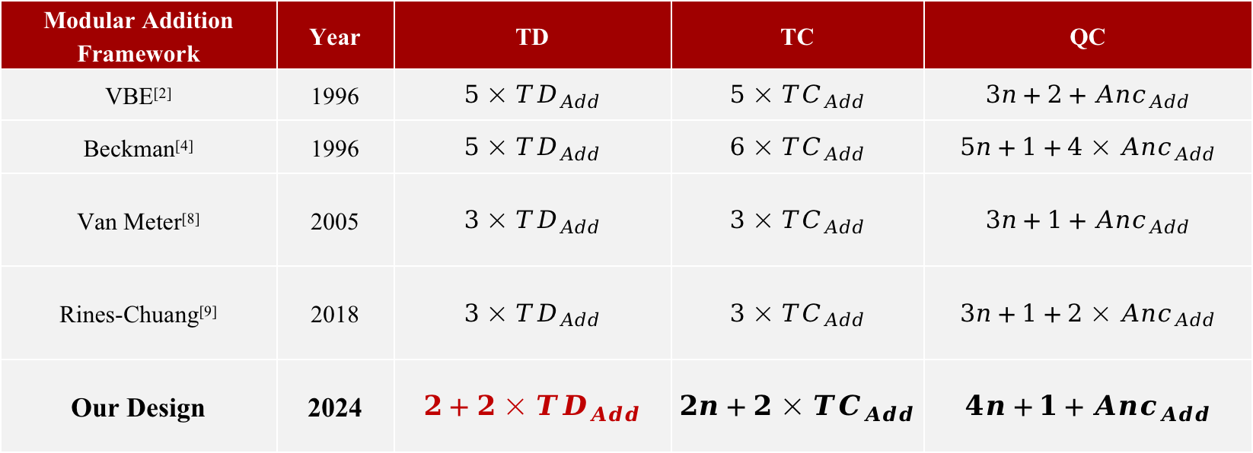
Results
Experiment 1: Comparison with Prominent Quantum Modular Addition Frameworks.
Performance Estimation of Different Quantum Modular Addition Frameworks.
Modular Addition Framework | Year | TD | TC | QC
VBE^{[2]} | 1996 | $$5×{TD}_{Add}$$ | $$5×{TC}_{Add}$$ | $$3n+2+{Anc}_{Add}$$
Beckman^{[4]} | 1996 | $$5×{TD}_{Add}$$ | $$6×{TC}_{Add}$$ | $$5n+1+{4×Anc}_{Add}$$
Van Meter^{[8]} | 2005 | $$3×{TD}_{Add}$$ | $$3×{TC}_{Add}$$ | $$3n+1+{Anc}_{Add}$$
Rines-Chuang^{[9]} | 2018 | $$3×{TD}_{Add}$$ | $$3×{TC}_{Add}$$ | $$3n+1+{2×Anc}_{Add}$$
Our Design | 2024 | $$2+2×{TD}_{Add}$$ | $$2n+2×{TC}_{Add}$$ | $$4n+1+{Anc}_{Add}$$
Theoretically, our design achieves the lowest TD

Slide 13
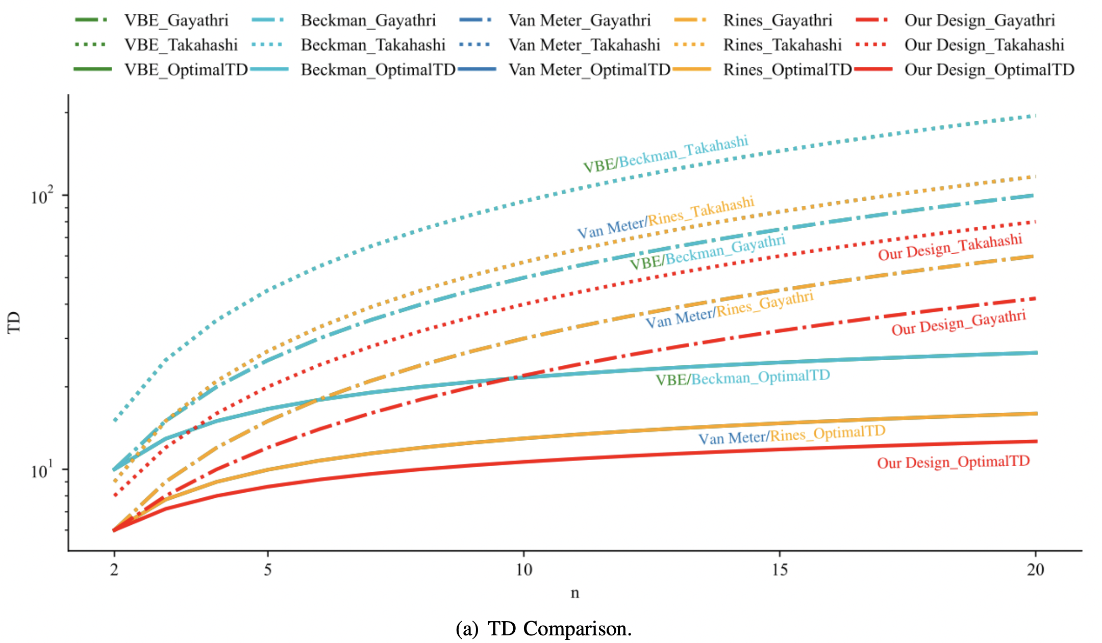
Results
Experiment 1
Our Design_Takahashi
Takahashi: low QC Adder
Our Design_Gayathri
Gayathri: low TC Adder
Our Design_OptimalTD
OptimalTD: low TD Adder
33.3%
TD Comparison
TD (Time)
Improvement

Slide 14
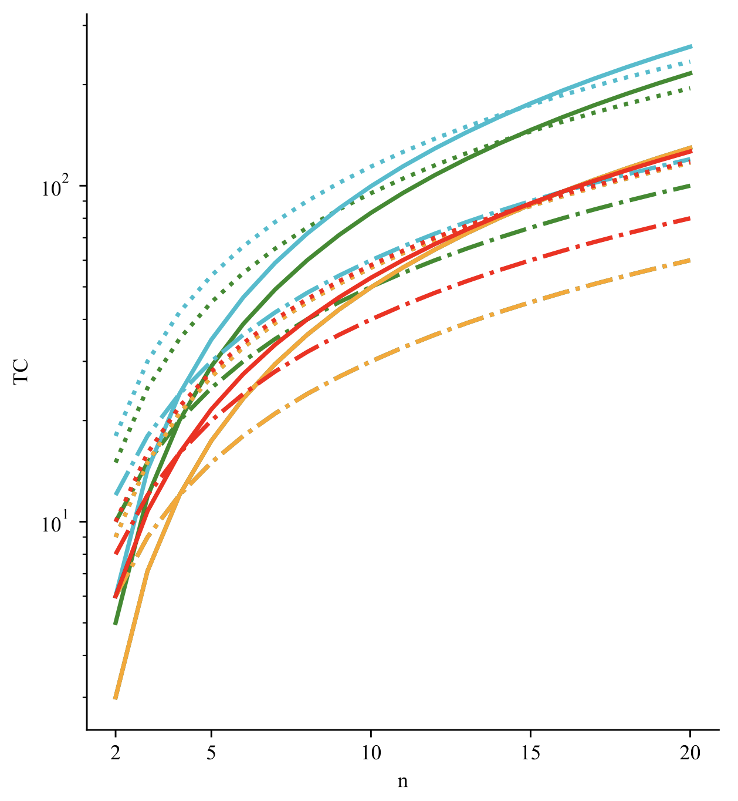
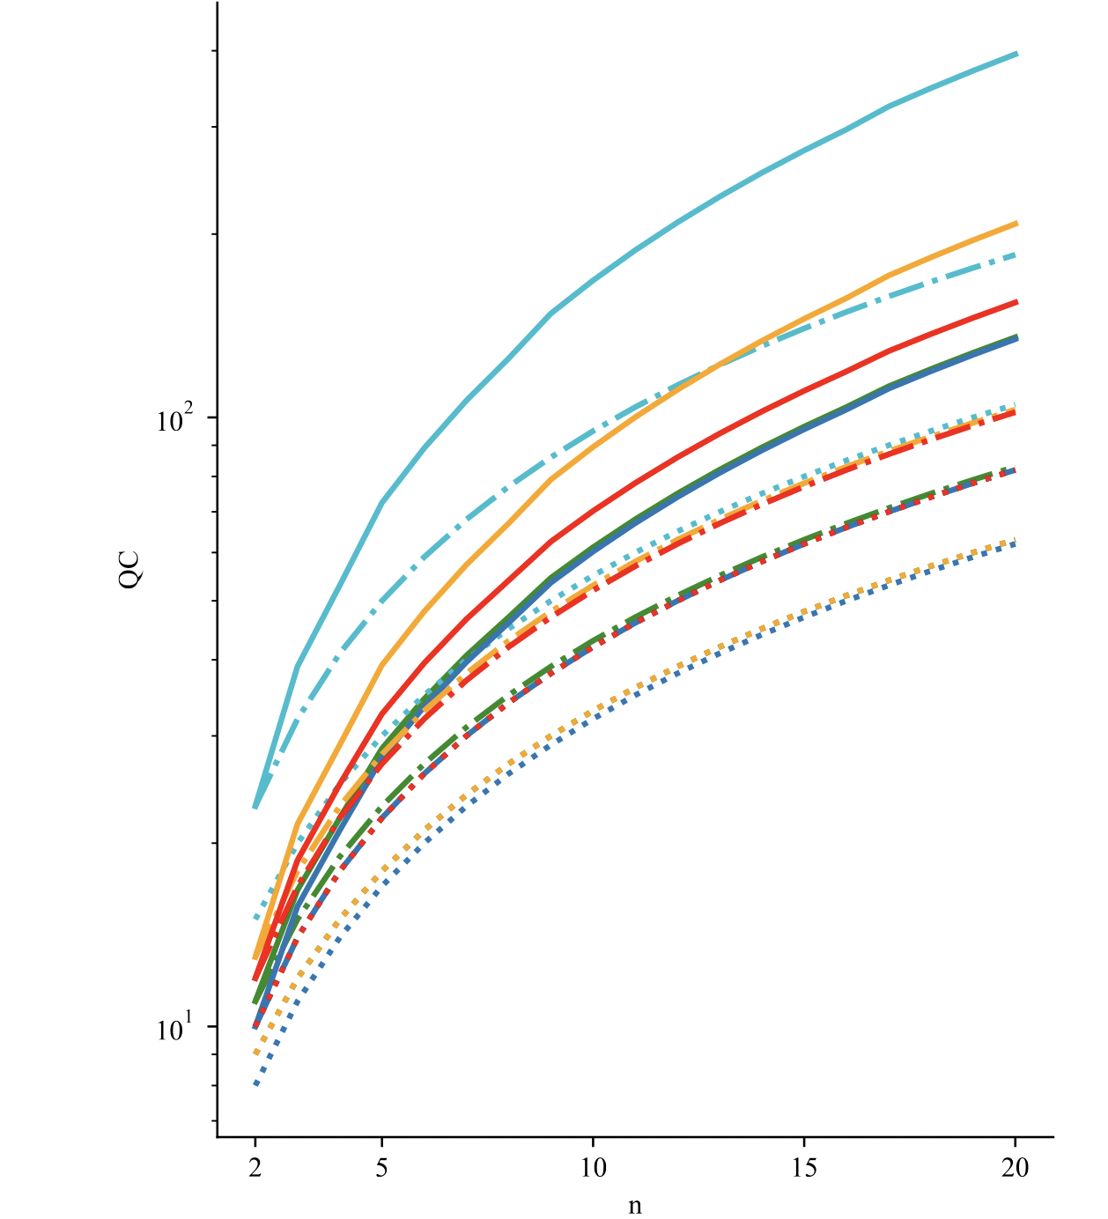
Results
Experiment 1
Toffoli-Count (TC)
Rines-Chuang framework with Gayathri Add achieves the lowest TC cost, with our design closely following as the second lowest.
Qubit-Count (QC)
Our design exhibits a QC that falls slightly below the Beckman framework.
Discussions
The choice of Add Block and Modular Framework significantly impacts the performance of modular adders.
Our designs exhibit up to 33.3% reduction in TD, while keeping TC and QC at comparable levels.
TC Comparison
QC Comparison

Slide 15
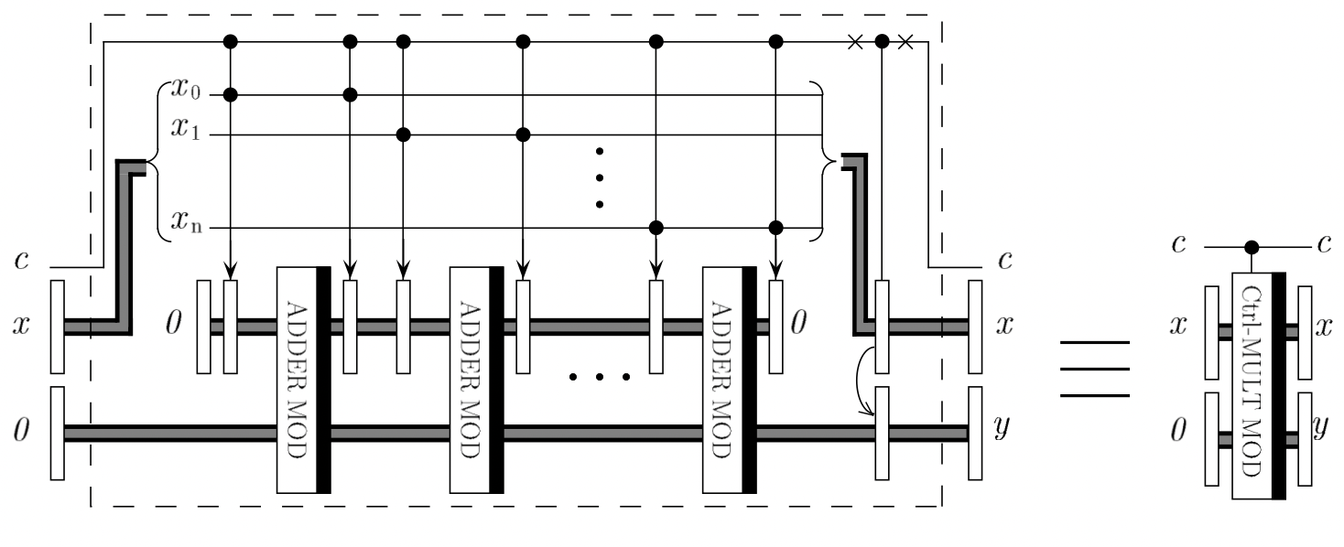
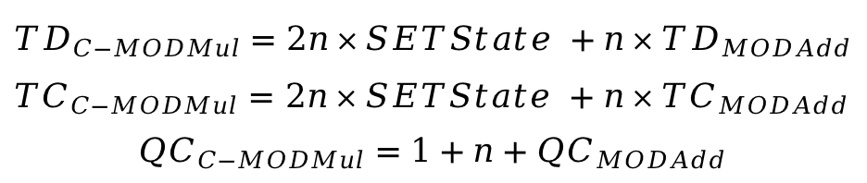
Results
Experiment 2: Influence on Quantum Modular Exponentiation
VBE Modular Multiplication Framework^{[2]}
SETState
Modular Adder
$${TD}_{C−MODMul}=2n×SETState +n×{TD}_{MODAdd}$$
${TC}_{C−MODMul}=$ $2n×SETState +n×{TC}_{MODAdd}$ $${QC}_{C−MODMul}=1+n+{QC}_{MODAdd}$$

Slide 16
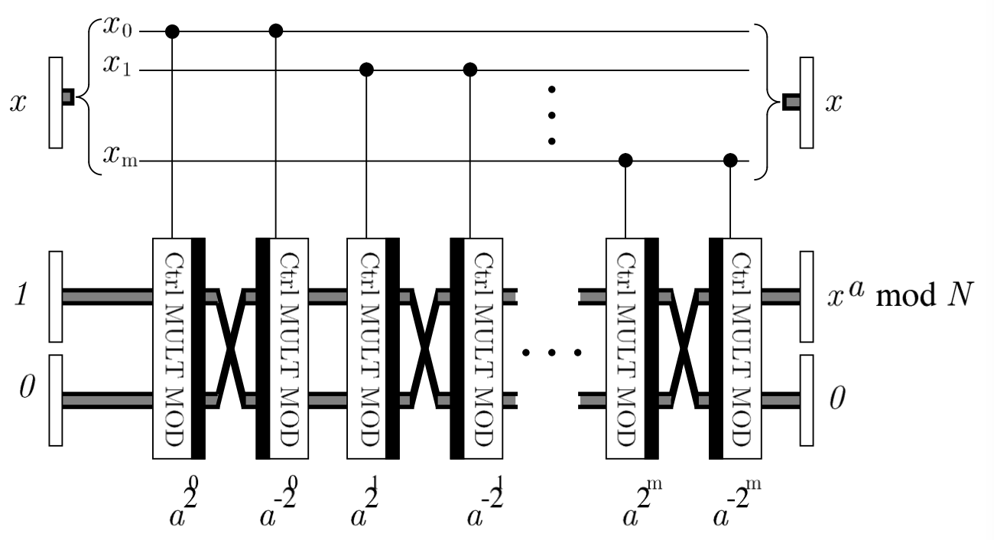
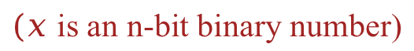
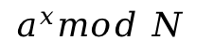
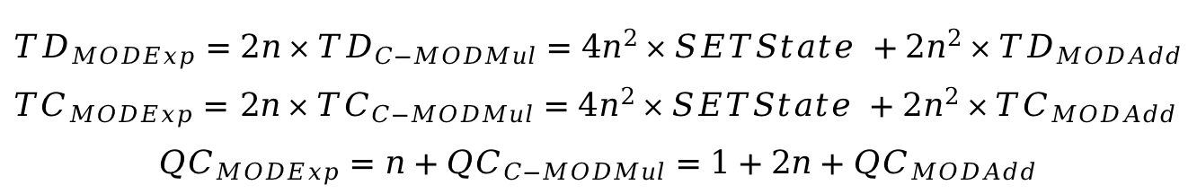
Results
Experiment 2
VBE Modular Exponentiation Framework^{[2]}
n-bit controlled modular multiplier
$$a^{x}mod N$$
$(x$ is an n-bit binary number)
60%
$${TD}_{MODExp}=2n×{TD}_{C−MODMul}=4n^{2}×SETState +2n^{2}×{TD}_{MODAdd}$$
${TC}_{MODExp}=$ $2n×{TC}_{C−MODMul}=4n^{2}×SETState +2n^{2}×{TC}_{MODAdd}$ $${QC}_{MODExp}=n+{QC}_{C−MODMul}=1+2n+{QC}_{MODAdd}$$
TD (Time)
Improvement

Slide 17

Conclusion
In this paper, we focused on exploring innovative designs to enhance the efficiency of quantum modular addition.
33.3%
1
Highlight the potential of carry-save architecture by enhancing the performance of quantum arithmetic designs.
Improve TD (Time) of
Quantum Modular Framework
2
Reduce the depth of quantum modular addition by proposing a novel framework based on carry-save architecture.
60%
3
Accelerate Shor’s algorithm through improving quantum modular addition efficiency.
Improve TD (Time) of
Quantum Exponentiation

Slide 18
Conclusion
Ms. Luisa’s Story...
With a powerful quantum computer
Use our design as modular addition block
Attack time for quantum hacking is reduced:
From 8 Hours to 4.8 Hours

Slide 19








International Women in Engineering Day (INWED 2025)
June 20, 2025, Singapore.
Thank You for Listening!
Manuscript
LinkedIn

Slide 20
Q&A

Slide 21
References
[1] Shor, P.W., 1999. Polynomial-time algorithms for prime factorization and discrete logarithms on a quantum computer. SIAM review, 41(2), pp.303-332.
[2] Vedral, V., Barenco, A. and Ekert, A., 1996. Quantum networks for elementary arithmetic operations. Physical Review A, 54(1), p.147.
[3] Beckman, D., Chari, A.N., Devabhaktuni, S. and Preskill, J., 1996. Efficient networks for quantum factoring. Physical Review A, 54(2), p.1034.
[4] Van Meter, R. and Itoh, K.M., 2005. Fast quantum modular exponentiation. Physical Review A—Atomic, Molecular, and Optical Physics, 71(5), p.052320.
[5] Rines, R. and Chuang, I., 2018. High performance quantum modular multipliers. arXiv preprint arXiv:1801.01081.
[6] Gayathri, S.S., Kumar, R., Dhanalakshmi, S., Kaushik, B.K. and Haghparast, M., 2021. T-count optimized wallace tree integer multiplier for quantum computing. International Journal of Theoretical Physics, 60(8), pp.2823-2835.
[7] Takahashi, Y., Tani, S. and Kunihiro, N., 2009. Quantum addition circuits and unbounded fan-out. arXiv preprint arXiv:0910.2530.
[8] Wang, S., Deb, S., Mondal, A. and Chattopadhyay, A., 2024. Optimal Toffoli-Depth Quantum Adder. arXiv preprint arXiv:2405.02523.

